Slide 1
Cyclistic Increasing Bikeshare Company’s Membership
Reinhard Shanahan Simba
28 July 2023

Slide 2
Hello!
My name is Reinhard Shanahan Simba
My contacts:
Email: reinhardshenzl@gmail.com
LinkedIn: www.linkedin.com/in/reinhard-shanahan-simba-b13124284
GitHub: https://github.com/ReinhardShen

Slide 3
Agenda
Background
Business Questions
Goals
Data
Key Findings
Suggestions
Things to Consider
Data Sources

Slide 4
Background
Cyclistic has 2 types of membership:
Casual (single-ride and full-day passses)
Annual
But, annual members are more profitable than casual riders.
To maximize profitability = converts casual riders into annual members.

Slide 5
Business Questions
How do annual members and casual riders use Cyclistic bikes differently?
Why would casual riders buy Cyclistic annual memberships?
How can Cyclistic use digital media to influence casual riders to become members?

Slide 6
Goals
Design marketing strategies aimed at converting casual riders into annual members.

Slide 7
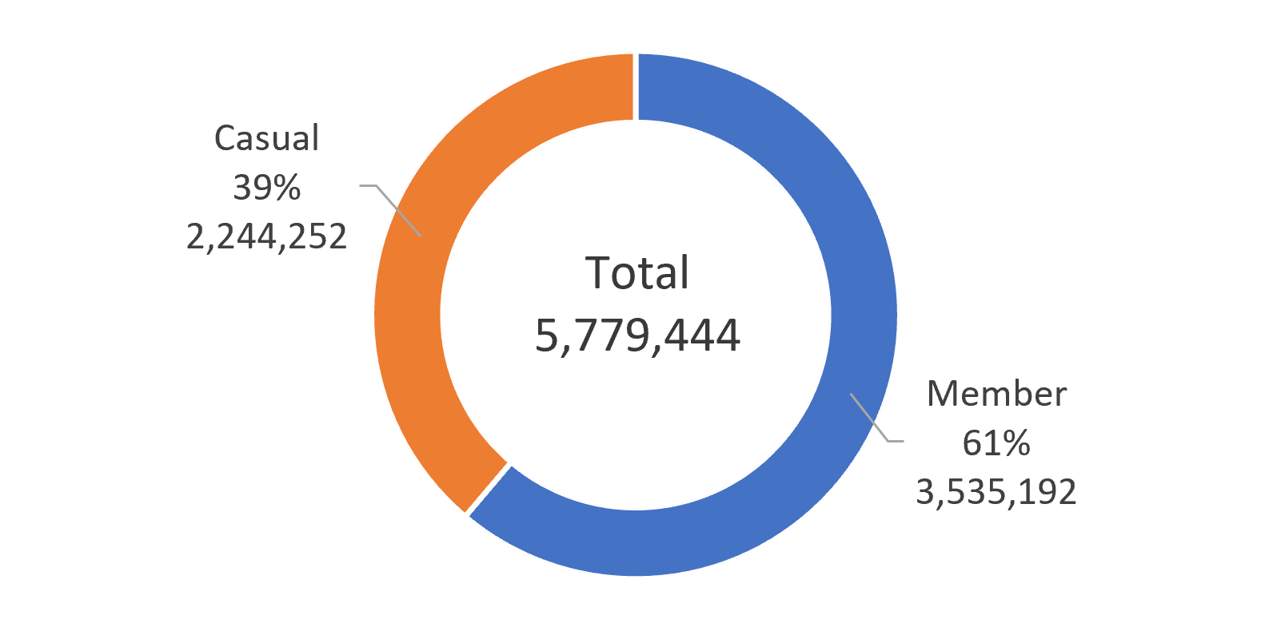
Total Rides by Memberships

Slide 8
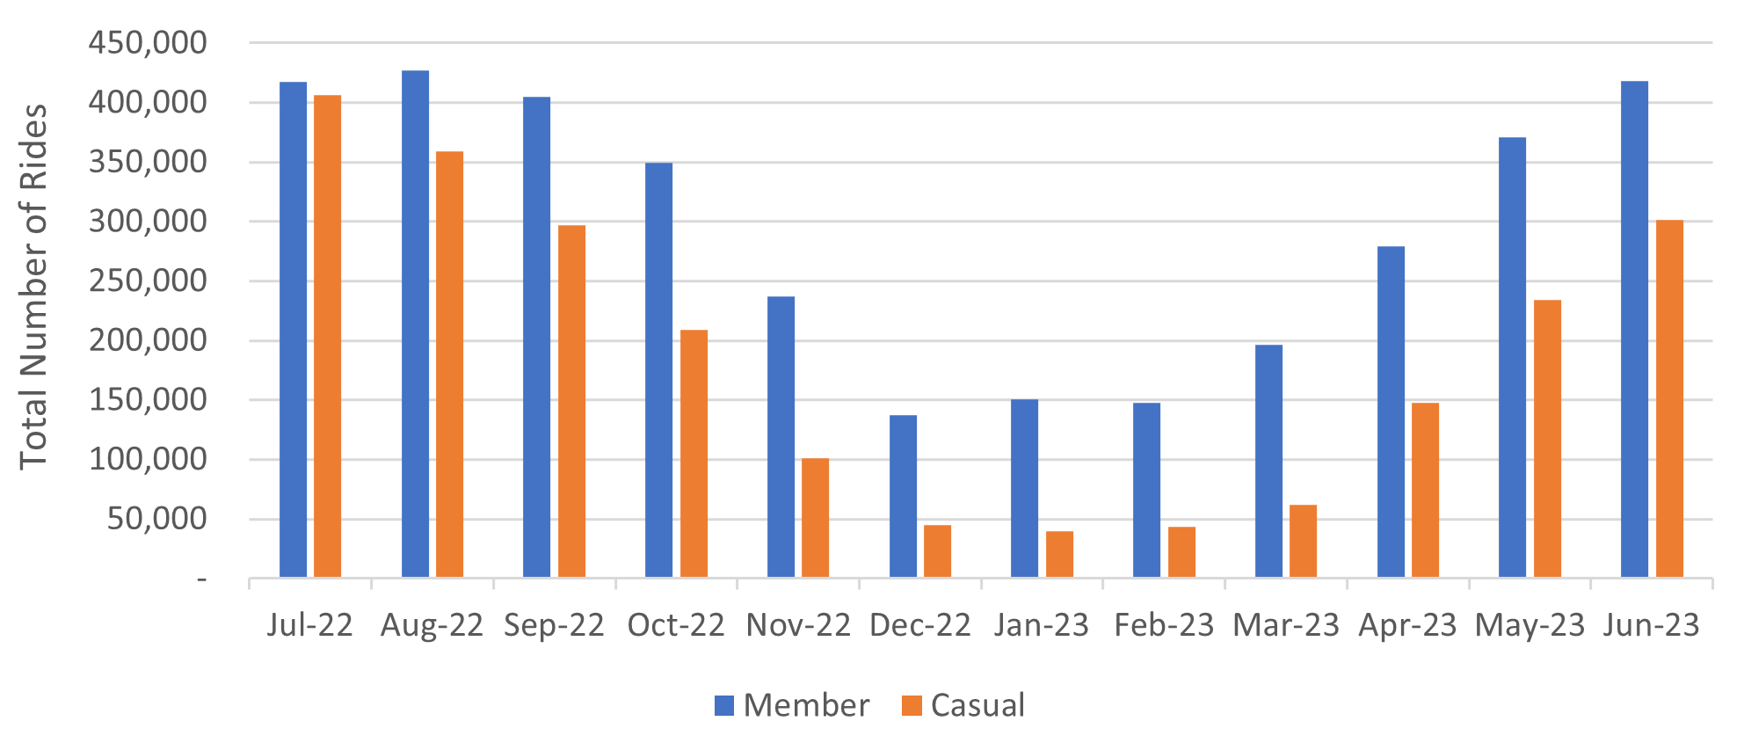
Total Rides per Months for 1 Year

Slide 9
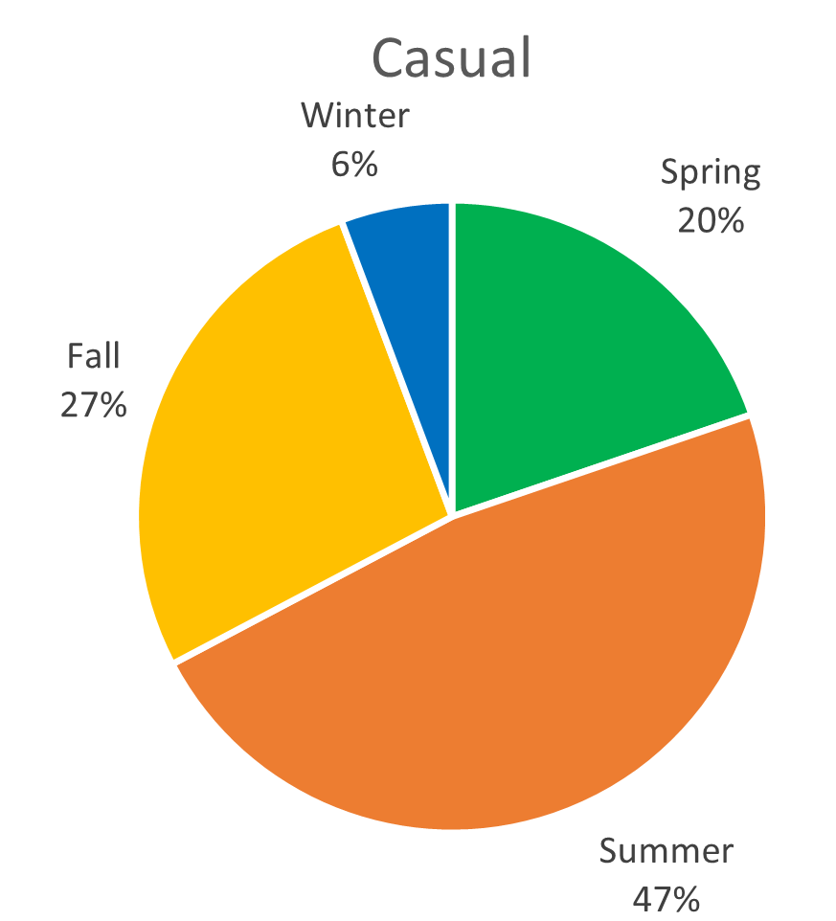
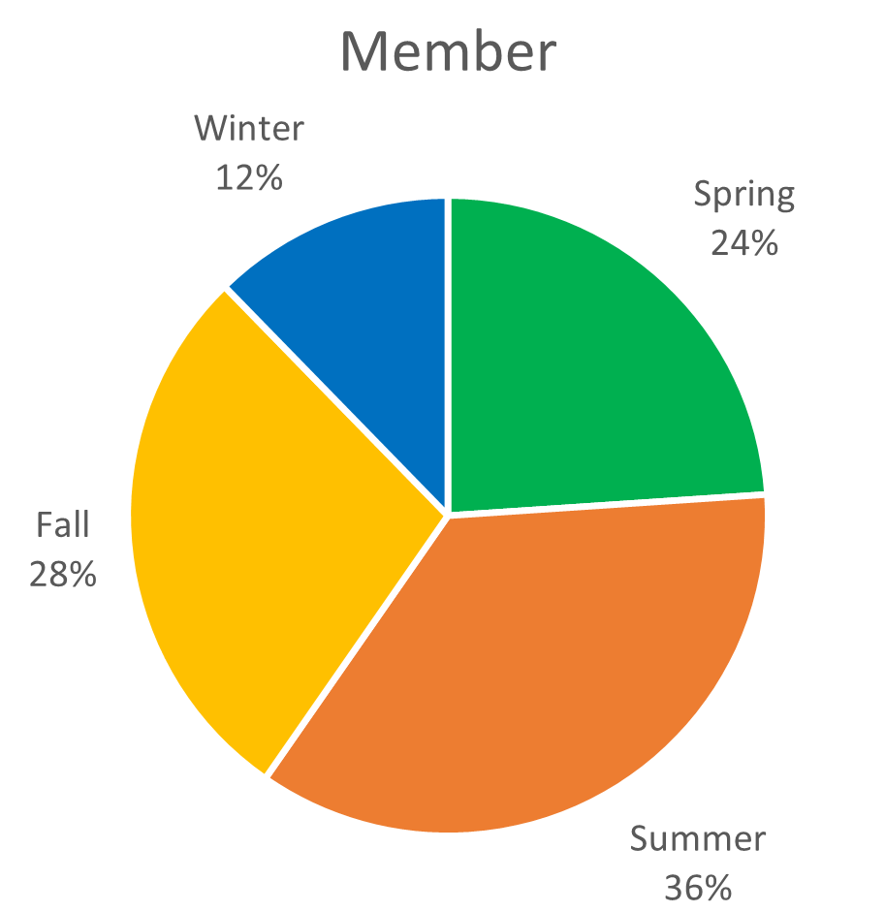
Total Rides per Seasons for 1 Year

Slide 10
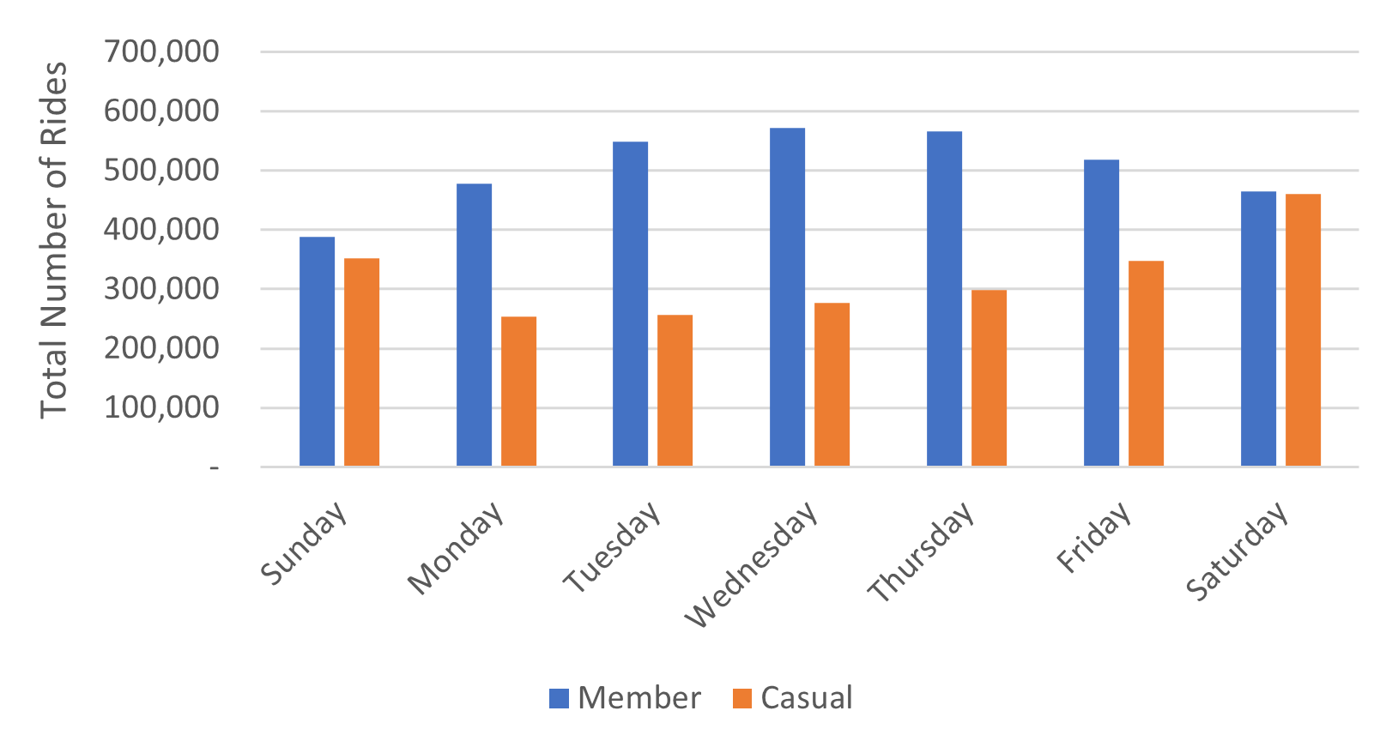
Total Rides per Days for 1 Year

Slide 11
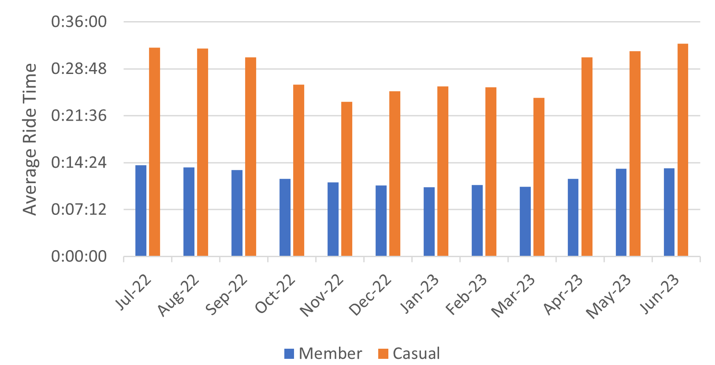
Average Ride Time by Months for 1 Year

Slide 12
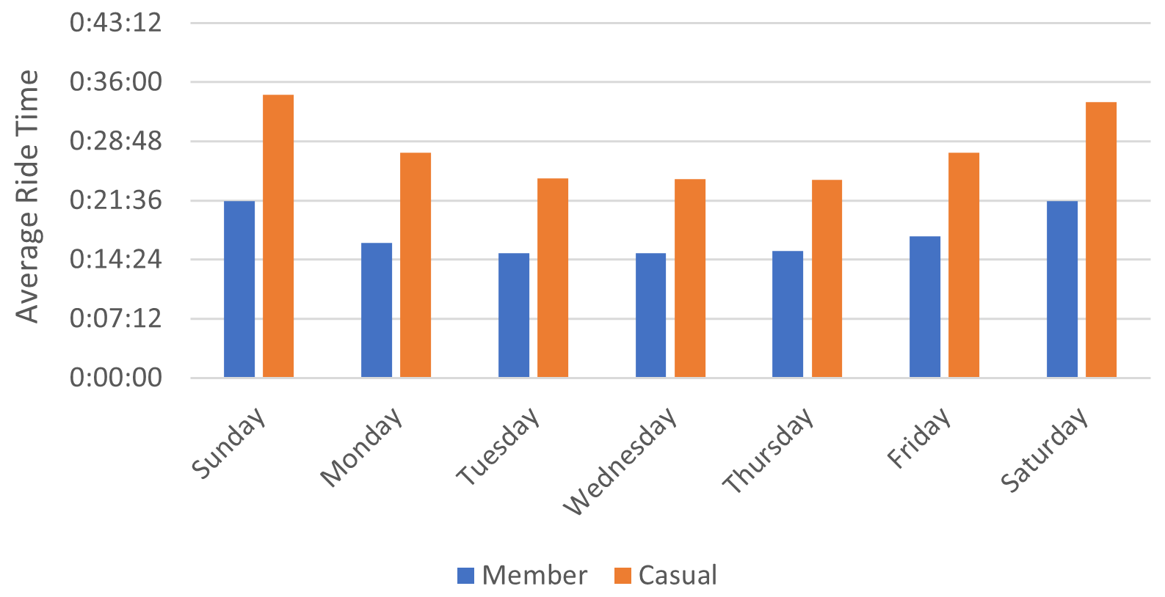
Average Ride Time by Days in 1 Year

Slide 13
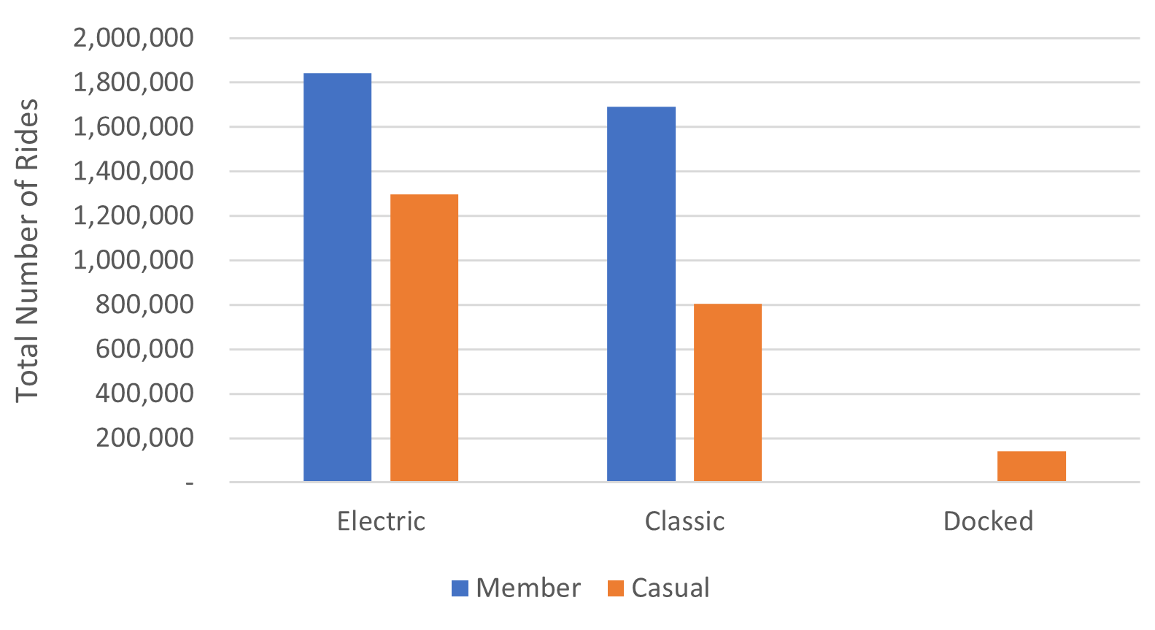
Total Rides by Types of Bike

Slide 14
Key Findings
Cyclistic already has more annual members (61%) compared to casual riders (39%)
Annual members tended to ride more, compared to casual riders.
Both members and casual riders rode more in summer and fall and rode less in spring and winter. So, riders tended to ride more in warmer weather rather than colder.

Slide 15
Key Findings
From daily data, we can see that members rode more in weekdays compared to casual riders that rode more in weekends.
Casual riders tended to ride longer than the members.
Also, casual riders ride time duration were heavily influenced by weather and days compared to members’ ride duration which were more stable (due to routine activities).

Slide 16
Key Findings
From bike types data, we can see that both members and casual riders tended to ride more electric bike compared to classic and docked bike.
Docked bike type seemed to be the least favorite that there’s no member’s ride data in this bike type.

Slide 17
Suggestion 1
We can try to make tier for annual memberships.
Example: in addition on annual membership, we can add “Weekends Membership” that offers unlimited pass only every weekends as most casual riders rode more in weekends.
With tier system, casual riders maybe will be more comfortable with the price and be more interested in memberships.
As the riders feel more comfortable with the plan, they will upgrade their memberships to full annual membership.

Slide 18
Suggestion 1
In addition of “Weekends Membership”, we can add another tier such as “Pay-per-use Membership” that allows riders to ride the bike as much as the balance in their cards.
We believe that with this way, more casual riders will be more comfortable and interested to join this membership and once they feel comfortable, they will upgrade to full annual membership.

Slide 19
Suggestion 2
We can provide more promos but only for members in various occasions like during warmer weather (summer, fall, and spring) as most riders use the bike during this time.
We hope with these promos, the casuals will be more interested in annual memberships considering the much more benefits compared to casual ride.

Slide 20
Suggestion 3
We can provide more appealing data and visualizations about the benefits of Cyclistic and also the benefits of annual membership.
We can provide the data like:
How much gas/petrol money and CO₂ that the rider has saved by riding Cyclistic instead of car or motorcycle.
How much calories the rider has burned by riding Cyclistic and describes the health benefits of cycling.

Slide 21
Suggestion 3
And from there, we can start describing the benefits of annual membership like:
By purchasing annual membership, you can save money up to 25%.
Unlimited ride everywhere and every time.
Unlimited use of inbuilt GPS and map.
1 week trial, cancel anytime.

Slide 22
Things to Consider
Demographic data: like gender, age, and others. These data will help us to make more accurate analysis like gender and age can determine someone’s occupation (worker or student), so we can know who are our majority customers.
Benefits data: like the benefits of annual memberships. This data will help us to know the benefits’ differences between members and casual riders. So, we can determine which benefits/services are the best for members.

Slide 23
Sources
Data Sources: Index of bucket "divvy-tripdata“ July 2022 to June 2023 (one year data)

Slide 24
Thank you

